Slide 1
Art Virtual Learning
11th-12th /College Photography
Memes
April 6th, 2020

Slide 2
11th-12th/College Photography
Lesson: April 6th
K. Campbell
Objective/Learning Target:
To complete and submit your 2 memes (required for those signed up for UCM dual credit-please note I follow UCM timeline and they started online class March 30th-you should have gotten an email from me March 30th with how we will conduct the class) Those not doing dual credit through UCM, do lessons/projects as you are able-optional

Slide 3
Meme Project start April 6th
“A meme Examples of memes include
Objective: To complete and submit your 2 memes (required for those signed up for UCM dual credit-please note I follow UCM timeline and they started online class March 30th-you should have gotten an email from me March 30th with how we will conduct the class) Those not doing dual credit through UCM, do lessons/projects as you are able.
Bell ringer:
Research memes on whatever social platform you are a member of or
Task: Think of a meme that really got your attention. Was it funny? Did it include a belief, fashion, story or just a funny phrase?
Task 2: Look through your social media platforms and save the funny memes you find for reference.
Announcements:
(*****THIS CLASS MAY BE DONE DIFFERENTLY THAN YOUR OTHER NON DUAL CREDIT
CLASSES IN ISD WHEN YOU RECEIVE AND GO ABOUT DOING THE CLASS). Grading:
UCM Dual Credit students: Those signed up for dual credit with UCM will be required to submit work as directed (google classroom and/or Twitter with appropriate @ and #). YOUR WORK WILL BE GRADED AND WILL REFLECT THAT IN THE GRADEBOOK. ANSWER YOUR RESPONSES IN THE COMMENT SECTION OF PROJECT SUBMISSION IN GOOGLE CLASSROOM. Or send in an email to me. I don’t need the questions, just your responses.
Other students in the class:
Those just taking the class, please participate as you are able and I will put a check mark as collected in the gradebook. Those who are doing UCM dual credit will appreciate your assistance with comments/likes on Twitter etc..
OTHER NOTES:
Post your two favorite Meme’s on Twitter as per criteria and RETWEET your favorite 2 classmates memes. I will look for all RETWEETS TO BE DONE BY APRIL 10th.
I will also have to repost all info found here in google classroom, but it may not be daily like it is here.
Those who have not turned in Panoramas please do so if you are able, those doing the actual dual credit
must turn in for a grade by April 3rd. Many have posted on Twitter so you can like, comment etc...
Please email me with questions and concerns. I will do my best to reply within 24hours. Also be aware
that my reply will have a supervisor on the CC as I cannot do private replies.
See next page for Meme criteria/scoreguide
is a concept or behavior that spreads from person to person.
beliefs, fashions, stories, and phrases.”

Slide 5
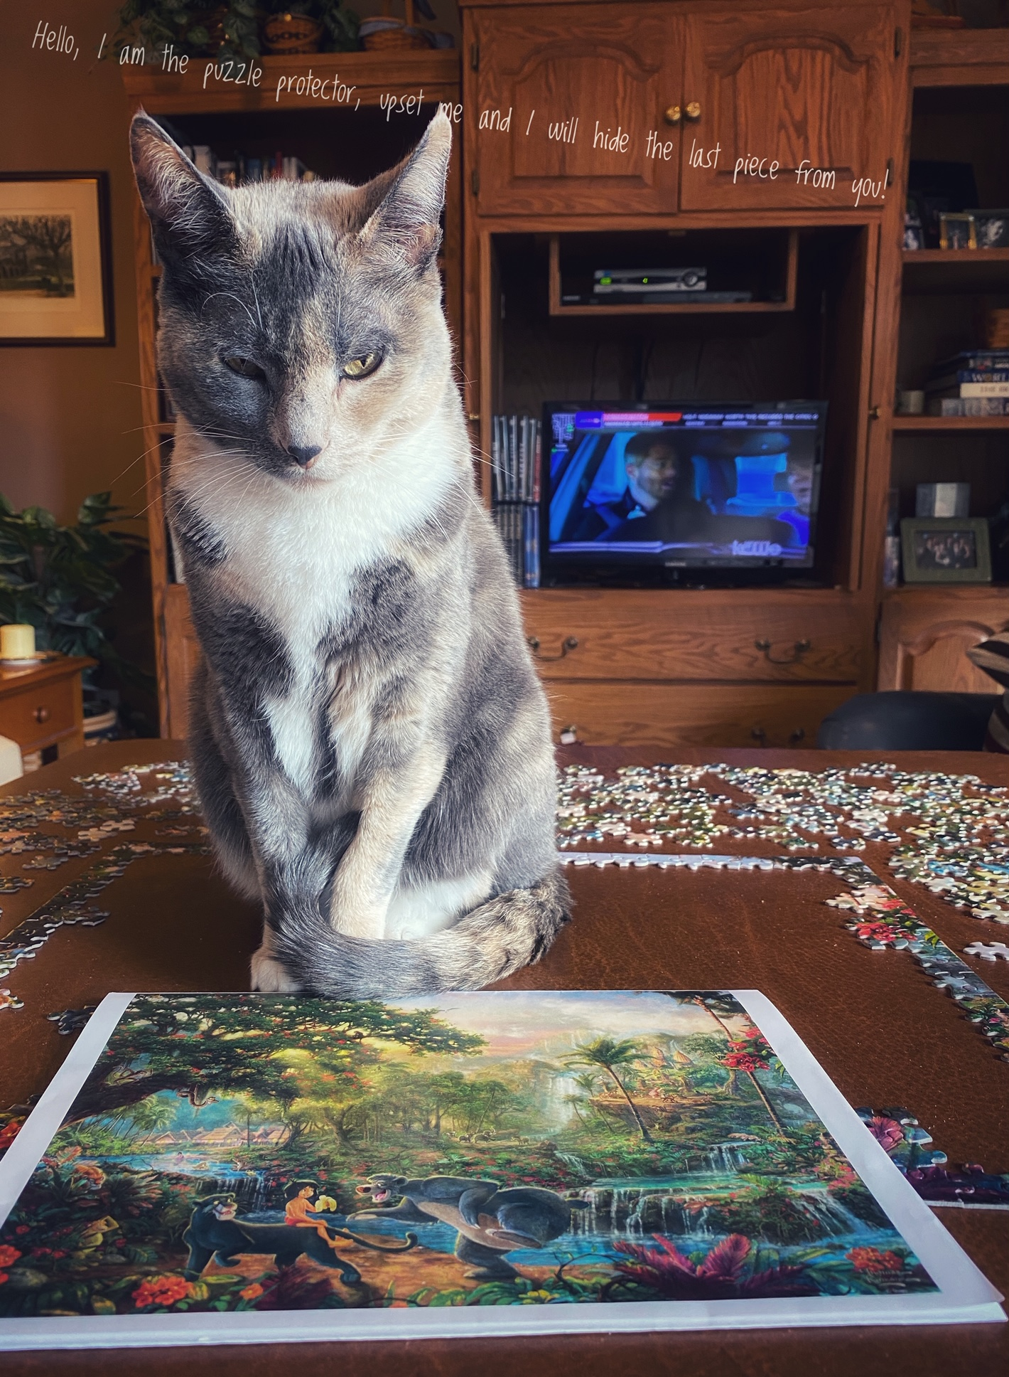
Examples (I will also post on Twitter): I edited photos on my phone and also used Snappseed APP to add words.

Slide 6
